Slide 1
Classification of respiratory diseases using Convolutional Neural Network
Submitted By
Jushraf Rahman-1812901042
Mir Sadia Afrin-1712366642
CSE499B Senior Project Design -II
Section: 12
Submitted To: Dr. Mohammad Ashrafuzzaman Khan

Slide 2
1.Problem analysis
What was the Problem
Why was it difficult
How did we address those
To classify respiratory diseases from a dataset containing 920 audio recordings of breathing sound
Dataset contained both Tabular data and Audio data.
Difficult to combine both.
Small Dataset
Lack of computational power
We converted audio files to image data (MFCC).
We fed them as input to our CNN and VGG16 models
We used Google Colab to handle the computation.

Slide 3
2.Related work
Lung Disease Classification using Deep Convolutional Neural Network
LungBRN: A Smart Digital Stethoscope for Detecting Respiratory Disease Using bi-ResNet Deep Learning Algorithm
Α Respiratory Sound Database for the Development of Automated Classification
Deep learning based respiratory sound analysis for detection of COPD
Convolutional neural networks based efficient approach for classification of lung diseases
So far Paper 4 had the best accuracy which is 93 %

Slide 4
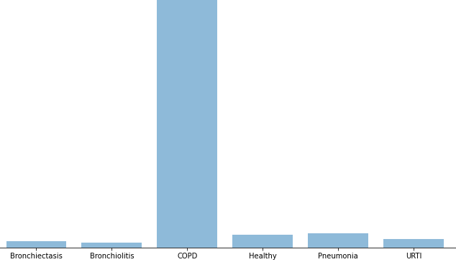
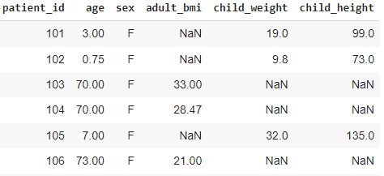
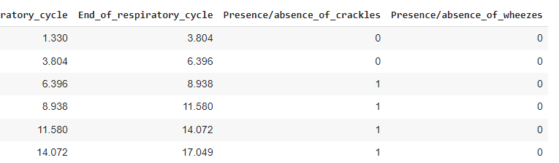
Data Exploration:
Fig: Disease Count
Fig: Demographic Table
Fig: Audio File Annotation

Slide 5
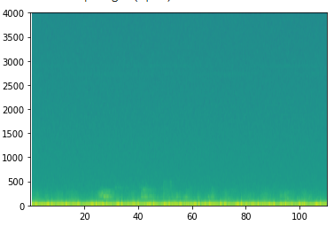
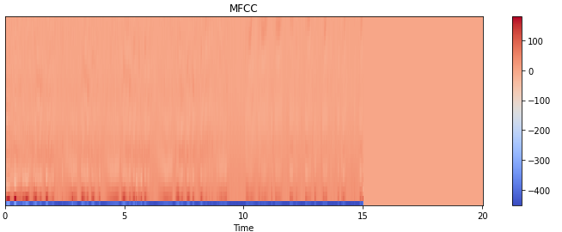

Pre-Processing:
Feature Extraction and conversion of audio file to spectrogram and MFCC
Removing least frequent diseases for better distribution.
Fig: Audio Spectrogram
Fig: MFCC (Mel-frequency cepstrum)

Slide 6
Models Used:
Convolutional Neural Network, VGG16 and ResNET
Work Distribution:
Jushraf Rahman : Mostly in charge of the coding
Pre-Processing and Model construction of CNN
Implemented VGG16 model
Mir Sadia Afrin : Mostly in charge of the documentation
Training and Testing of CNN model
Attempted ResNET50 model

Slide 7
5. Tools
TensorFlow, Librosa, Keras, scikit-learn, Numpy, Pandas
Google Colab
Jupyter Notebook
Kaggle
Google Scholar
Youtube Sources

Slide 8
4. Unique/original part of the project
Areas where there is lack of skilled medical staff , a sound classification using our model can provide immediate diagnostic reports.
Help the medically under-served population
Our model aims to improve the existing architecture by providing better accuracy

Slide 9
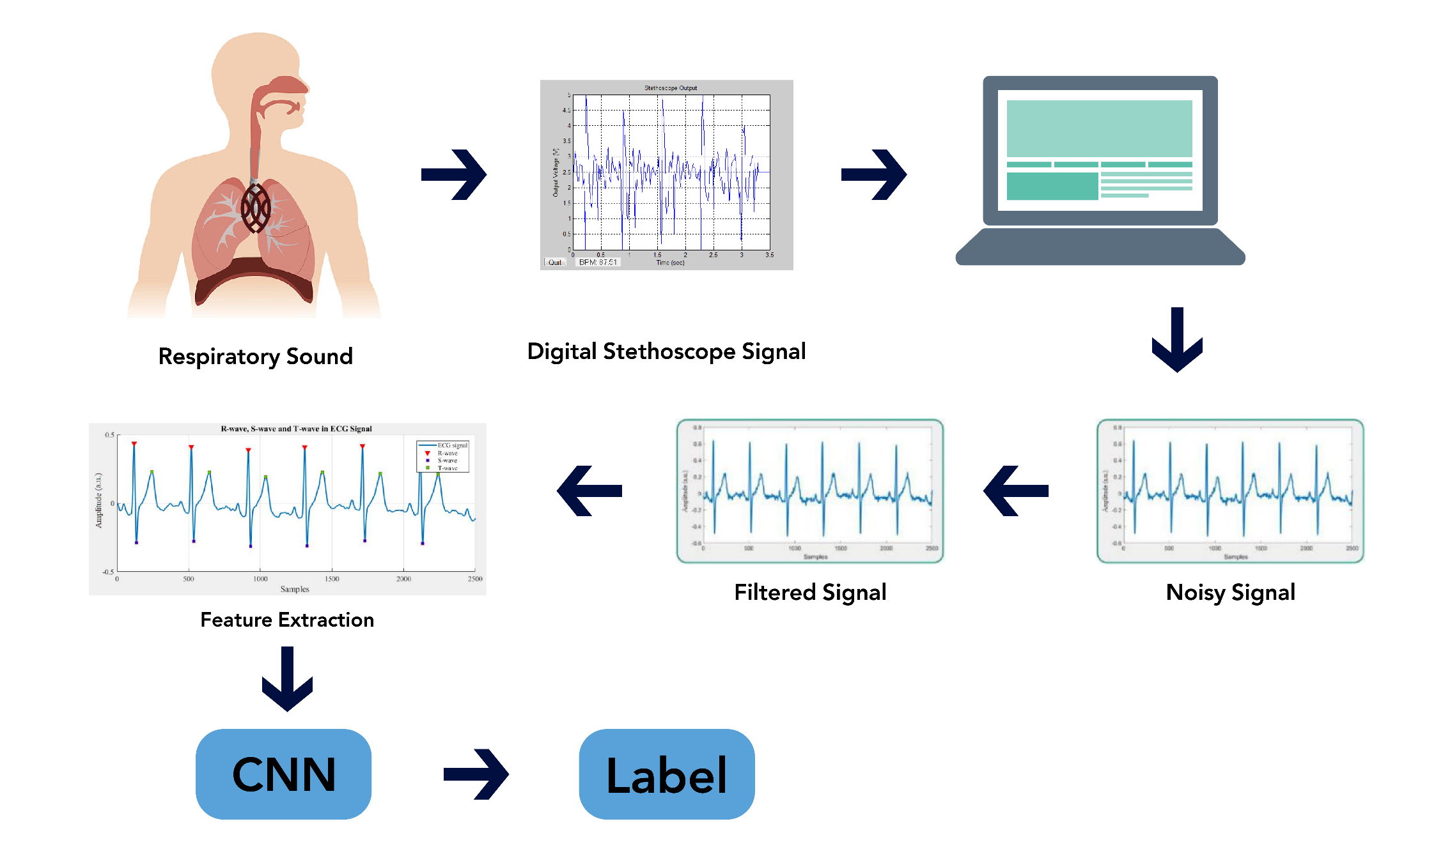
6. Project Design:
Fig: Overall Workflow

Slide 10
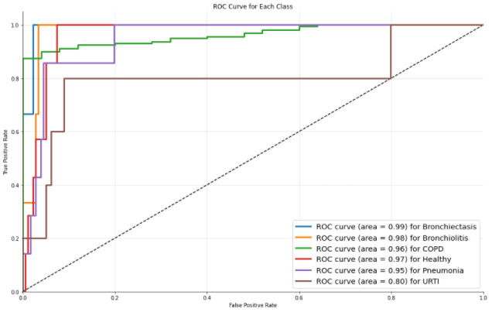
7. Result Analysis:
CNN : After full completion of 250 epochs
Training Accuracy : 92 . 9% Testing Accuracy : 86 . 95 %
Fig: ROC Curve

Slide 11
7. Result Analysis:
VGG16 : Completed only 2/100 epochs. Per epoch took approximately 4 hours time.
Training Accuracy : 83 . 71 %

